Slide 1

Sri Siddhartha Institute of Technology Tumakuru-572105 (A Constituent College of Sri Siddhartha Academy of Higher Education)
Mini-Project(CS5MP1) Presentation On:
PHISHING WEBSITE ANALYSER

Slide 2

PHISHING WEBSITE ANALYSER
Done by: CHIRAG P (21CS022) MAAZ PASHA(21CS123)
Under the guidance of: MRS. K NOOR FATHIMA Assistant Professor Department of CSE SSIT, Tumakuru-03 .

Slide 3


CONTENTS
Introduction
Objectives
Problem statement
Literature Survey
ER Diagram
Use Case Diagram
Methodology
Conclusion

Slide 4
Introduction
In the digital age, the internet is integral to daily life, enabling communication, commerce, and information exchange.
However, this increased reliance on online platforms has led to a significant threat – phishing attacks.
Phishing involves deceptive practices where malicious actors aim to trick individuals into revealing sensitive information, posing a substantial risk to security and privacy.
In response to this challenge, we introduce the "Phishing Website Analyzer," a meticulously designed Python tool.
This tool is dedicated to automating the detection of potential phishing websites, demonstrating our commitment to strengthening digital defenses.
The project addresses the need for a swift and accurate solution to assess the authenticity of online platforms.
By providing this tool, we aim to contribute to user security and privacy in the face of evolving cyber threats.

Slide 5
Objectives
Create algorithms to automatically identify phishing websites.
Develop an advanced content analysis module targeting phishing keywords and patterns.
Create a user-friendly web interface for easy URL submission and detailed analysis report retrieval.
Integrate a reporting system for detailed, actionable insights on phishing risks.
Develop a secure and efficient backend system for analyzing websites.
Integrate machine learning for improved phishing website detection accuracy.

Slide 6
Problem statement
The ubiquity of online activities establishes the internet as a backbone for communication, commerce, and information dissemination.
This digital landscape, however, faces a pervasive threat in the form of phishing attacks.
Cybercriminals employ sophisticated tactics, creating deceptive websites that mimic legitimate platforms to exploit unsuspecting users and compromise sensitive information.
Traditional methods to spot phishing sites depend on manual inspection, resulting in laborious and time-intensive processes that often lag behind evolving malicious strategies.
The tool needs to smoothly combine advanced techniques like checking URL structure, verifying domain age, validating SSL certificates, and scrutinizing content.

Slide 7
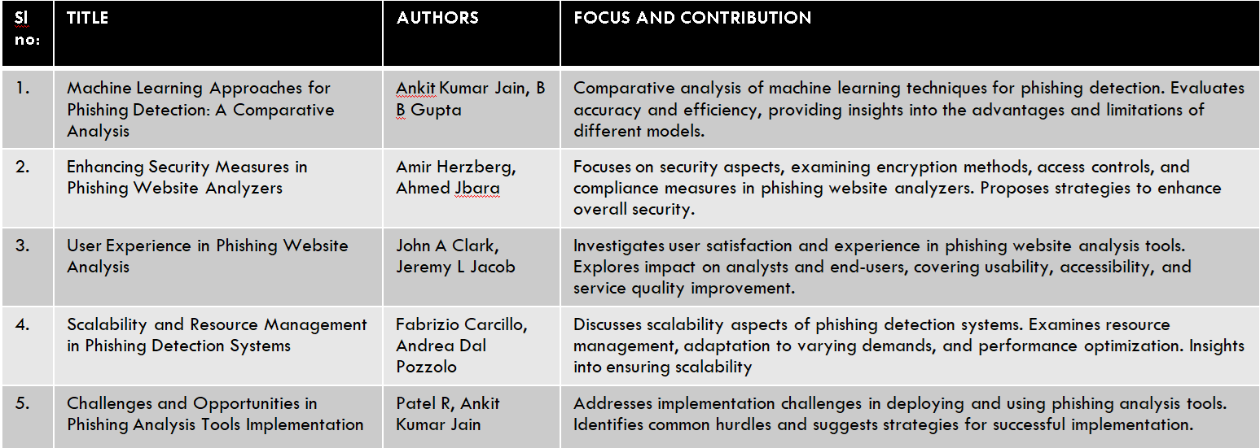
Literature survey

Slide 8
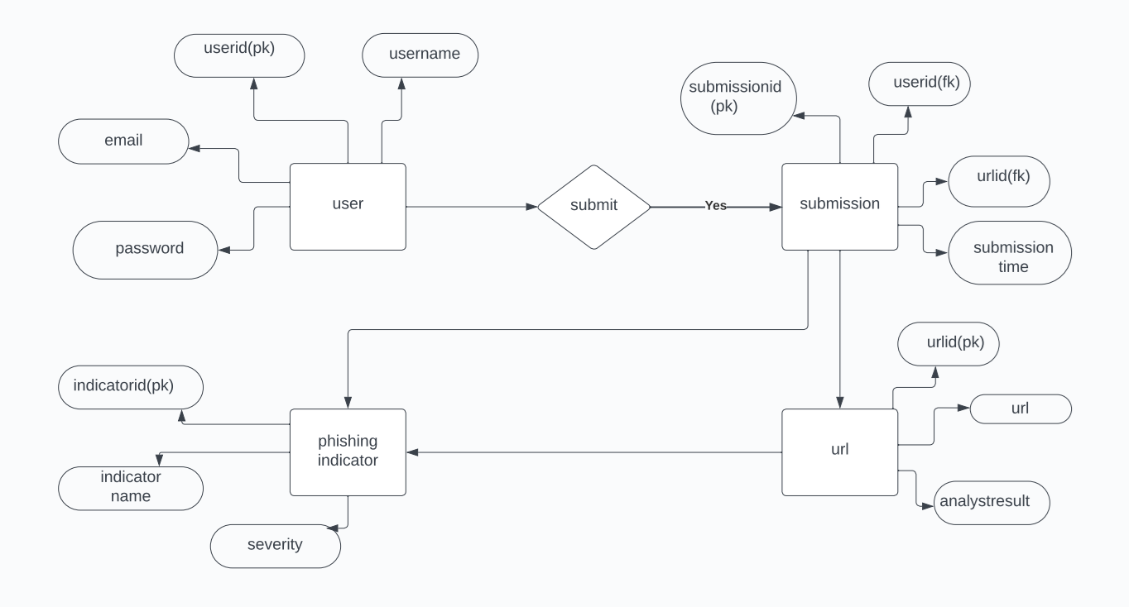
ER Diagram

Slide 9
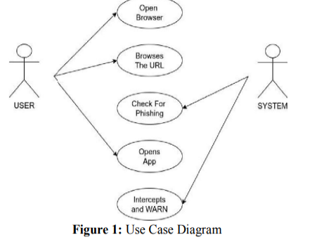
Use case diagram

Slide 10
Methodology
Identify the need to combat phishing attacks and understand the risks to user privacy.
Define the project scope and objectives, focusing on automating the identification of potential phishing websites.
Choose Python as the primary language and relevant libraries like Flask and BeautifulSoup.
Explore existing methodologies and review academic papers on machine learning, website analysis, and phishing detection.
Explore existing methodologies and review academic papers on machine learning, website analysis, and phishing detection.
Design an intuitive web interface for easy URL submission and receipt of detailed analysis reports.
Incorporate machine learning techniques to enhance phishing website detection accuracy.

Slide 11
Conclusion
The Phishing Website Analyzer is a proactive tool designed to enhance online security by reliably identifying potential phishing threats. Through seamless integration and comprehensive modules, including user interface, URL validation, HTML content retrieval, parsing, and phishing analysis, the project safeguards users from malicious online activities. The incorporation of machine learning adds a resilient and forward-thinking dimension, continuously adapting to evolving cyber security threats. Ultimately, the Phishing Website Analyzer represents a proactive measure fostering a culture of cyber security awareness.

Slide 12
Thank you
PHISHING WEBSITE ANALYSER by:
CHIRAG P & MAAZ PASHA

